Slide 1
Practising Interdisciplinarity: the start of a personal story
Sam Staddon
School of Geosciences | sam.staddon@ed.ac.uk
sIREN seminar workshop ‘Challenges and limitations of existing research methodology: inventing new methods for interdisciplinary research’
University of Edinburgh, 7 December 2016

Slide 2
Our remit…
Draw on your own research activities…
Provide attendees with information i.e. methods, strategies, challenges etc…
That will enhance their knowledge and skills in understanding interdisciplinary research
BUT…it’s actually all about YOU and being a reflexive researcher…learning from YOUR OWN experiences…
Notes:
So, I’m approaching that by telling you my own personal story in practising interdisciplinarity…
The information (methods, strategies, challenges) are clearly field-specific…
Re: enhancing knowledge and skills – I think this is actually about thinking and reflecting – being a reflexive researcher by drawing on what others say to help in learning from your own experiences…
I’m assuming you’re mostly PhD students and that’s who I’m aiming at here – given my own limited experience!

Slide 3
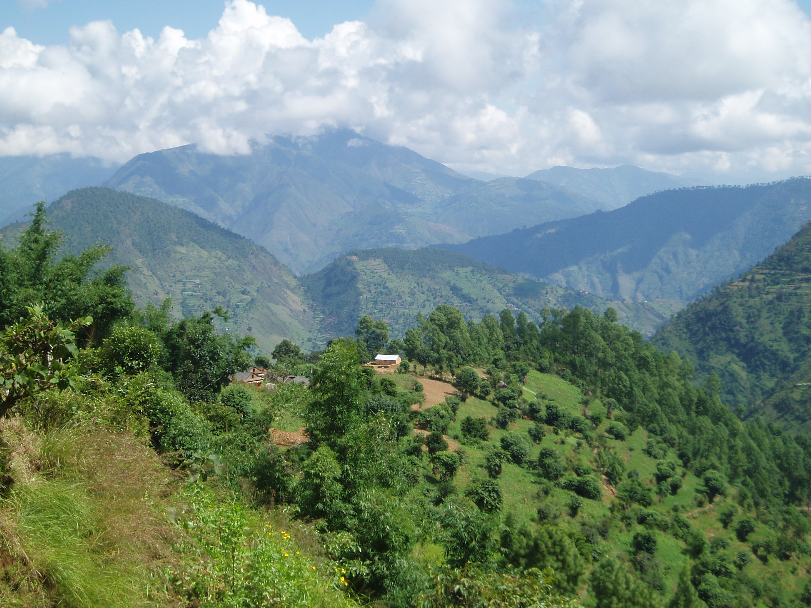
PhD thesis: ‘Keeping track of nature: interdisciplinary insights for participatory ecological monitoring’ (2012)
Notes:
So, I’m in Geography…but started in Conservation (practical work overseas for around 10 years)…moved from that back into academia to study people and their relationship to nature conservation…hence decision to do PhD on participatory i.e. community-based approaches to; ecological monitoring…

Slide 4






Interdisciplinarity
Notes:
1) Me at the start of my PhD – happy and excited!!
2) Just concentrating on having some GOOD IDEAS!!!
3) Then I realised that actually there were lots of OTHER ACADEMICS out there, and that it was about recognising how MY ideas related to those of OTHERs!!
4) …and that it was about how I communicated with those others – as they were people interested in TREES/FORESTS, or CONSERVATIONISTS into ANIMALS
…so it is about LANGUAGE/TERMS, METHODOLOGIES, EPISTEMOLOGIES…
e.g. submitting to a conservationist journal and being told “where is the data?? There are only quotes here??”

Slide 5
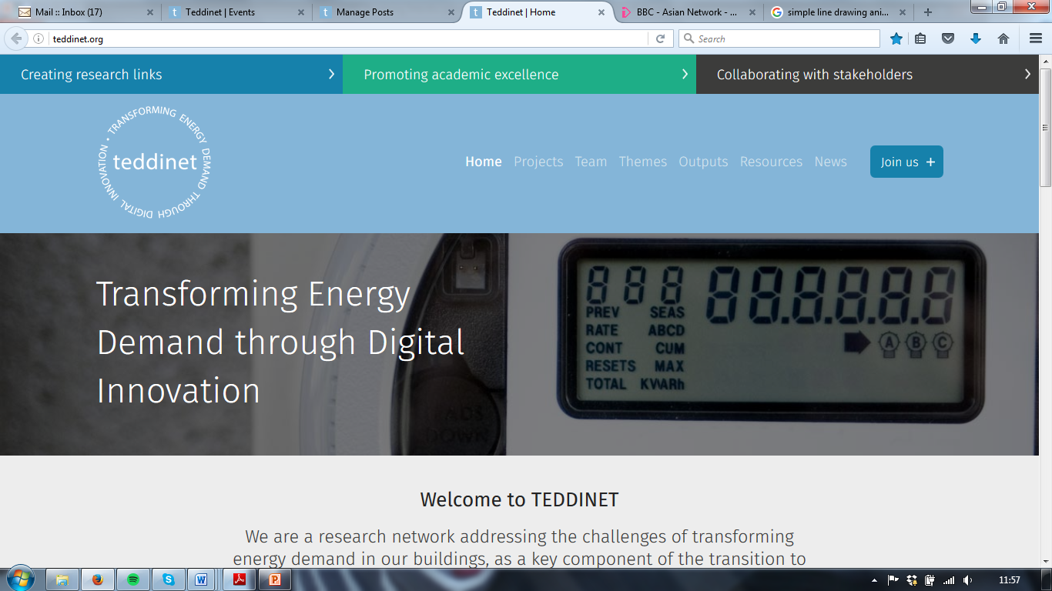
Notes:
So, I’ve been working last 3 years on a postdoc supporting a network of interdisciplinary research projects aimed at reducing energy demand in buildings (sounds completely different from PhD but is not!)

Slide 6
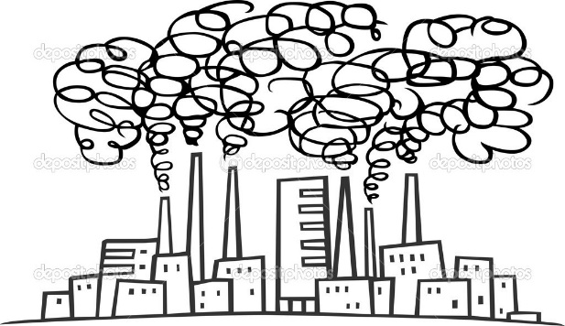

Interdisciplinarity
Transdisciplinarity
Notes:
5) So THEN realised it’s about all these OTHER STAKEHOLDERS e.g. industry, policy-makers, civil society, the public…i.e. TRANSDISCIPLINARY (> interdisciplinary)
6) …and trying to communicate with them!
e.g. joint workshops/events, going to their events/offices, understanding their own perspectives/drivers/concerns (e.g. ‘View from the Inside’)…
…this all links to the current IMPACT AGENDA so only likely to increase in importance…

Slide 7
Mallaband et al. (2017) The Reality of Cross-disciplinary Energy Research in the UK: A Social Science Perspective. Energy Research & Social Science, 25, 9-18
Challenges
Differing expectations of the role of social scientists
Working within academia
Feeling like a valued member of the team
Communicating and comprehension between disciplines
Notes:
So, what have I learnt/taken from these experiences so far?...
From TEDDINET and a workshop to reflect on role of ECR social scientists within the projects we support…led to a paper based on results…

Slide 8
Mallaband et al. (2017) The Reality of Cross-disciplinary Energy Research in the UK: A Social Science Perspective. Energy Research & Social Science, 25, 9-18
Negotiating the Challenges
Management and planning
Increasing contact
Sharing experience
Understanding team roles

Slide 9
Mallaband et al. (2017) The Reality of Cross-disciplinary Energy Research in the UK: A Social Science Perspective. Energy Research & Social Science, 25, 9-18
Logics of Interdisciplinarity (Barry et al. 2008)
Logic of Innovation
  e.g. social science used as a ‘service discipline’
Logic of Accountability
  e.g. social science used to legitimise research to the public
Ontological logic
  i.e. ontological and epistemological contributions of all disciplines valued and included

Slide 10
Equal participation in interdisciplinarity
‘Ontological logic’ (Barry et al. 2008)
‘Plural epistemologies’ (Nightingale 2016)
‘Epistemological interdisciplinarity’ (Klein 1996)

Slide 11
Equal participation in interdisciplinarity
Mode of local people’s participation | Type of participation | Outsider control | Potential for sustaining local action & ownership | Role of local people in research and action
COLLECTIVE ACTION | Local people set and implement their own agenda; outsiders absent |  | ********* | Directors
CO-LEARNING | Local people and outsiders share their knowledge to create new understanding and work together to form action plans; outsiders facilitate | ** | ****** | Partners
COLLABORATION | Local people work together with outsiders to determine priorities; outsiders have responsibility for directing the process | *** | ** | Collaborators
CONSULTATION | Opinions asked; outsiders analyse information and decide on a course of action | **** |  | Clients
CO-OPERATION | Tasks are assigned, with incentives; outsiders decide agenda and direct the process | ****** |  | Employees or Subordinates
CO-OPTION | Tokenism – representatives are chosen but have no real input or power | ********* |  | Subjects
Notes:
This actually relates to my work in participation by communities in NRM…but is equally valid for participation of disciplines in interdisciplinary research!

Slide 12
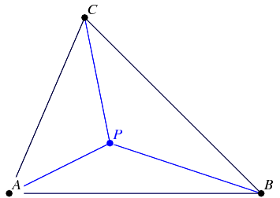
Triangulating multiple disciplines
(epistemologies)
2. Complementarity
1. Convergence
3. Divergence
(Nightingale 2003)

Slide 13
Why interdisciplinarity?
“Crucially, the goal of epistemological pluralism is not to form better predictions of change, but rather to think more creatively and widely about how to imagine response options and new development pathways”
(Nightingale 2016)

Slide 14
ESRC GCRF Fellowship: ‘Negotiating the ‘paradox of participation’ to increase the social equity of participatory ecological monitoring in Nepal’
Notes:
So, in the spirit of ‘thinking creatively’ – the next part of my story is starting in January…
…although actually I’ll be spending most of my time in Kathmamndu! (where the stakeholders are)

Slide 15
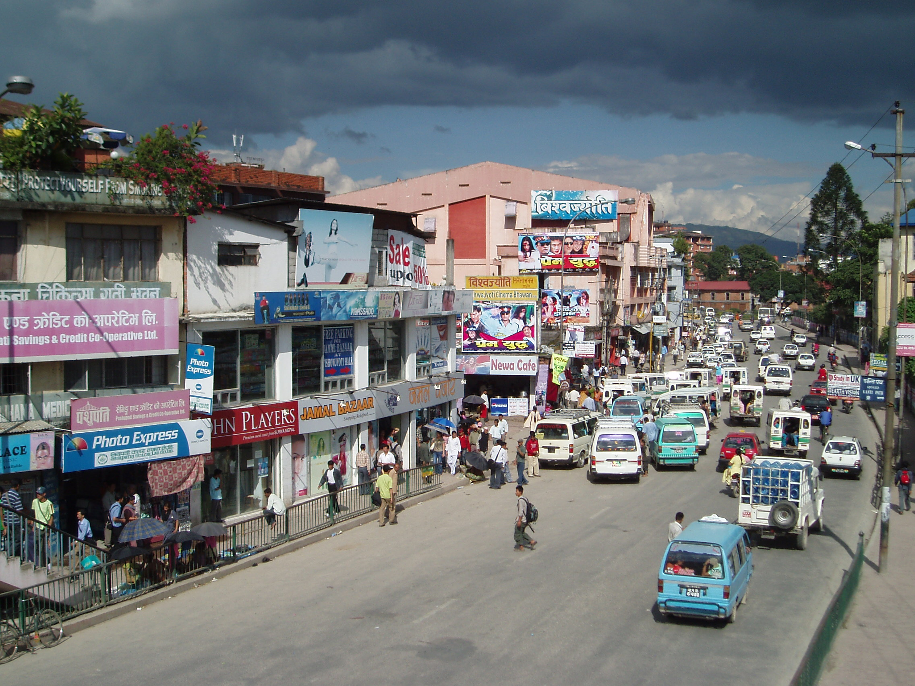
ESRC GCRF Fellowship: ‘Negotiating the ‘paradox of participation’ to increase the social equity of participatory ecological monitoring in Nepal’
Notes:
So, my next part of the story is starting in January…
I’m really interested here in the opportunities for TRANSDISCIPLINARITY…
…it’s all about PARTNERSHIPS & COLLABORATIONS…
…it’s an ETHICAL issue too…
Where do I want this new part of my story to take me?? To understand how we move from interdisc to transdisc effectively – what the issues involved are, how to negotiate challenges, what the limits are…

Slide 16

Key to successful inter(trans)disciplinarity
Social relations: openness, willingness to learn, personalities, respect, trust
Communication: telling, listening, sharing
Time: success can take time to develop
Expectations: of others, of the research
Equality: of disciplines, people, ideas
“Interdisciplinary research is a group activity and as such is underlain by power” (Campbell 2005)
Ethics + integrity: in all aspects of the research

Slide 17

Being reflexive
Why are you working inter(trans)disciplinarily?
  To solve a ‘wicked’ problem…
  Like working with diverse others…
  Challenge of working across epistemologies…
  Advocacy of a certain issue…
How can you deal with the challenges?
  Contributing to your own discipline…
  Career progression as an interdisciplinarian…
How can you do it better?

Slide 18
Resources
Barry A., Born G. & Weszkalnys G. (2008) Logics of Interdisciplinarity. Economy and Society, 37, 20-49
Campbell L. (2005) Overcoming Obstacles to Interdisciplinary Research. Conservation Biology, 19, 574-577
Klein J. (1996) Crossing boundaries: Knowledge, Disciplinarities and Interdisciplinarities. University of Virginia Press; Charlottesville, VA.
Nightingale A. (2016) Adaptive scholarship and situated knowledges? Hybrid methodologies and plural epistemologies in climate change adaptation research. Area, 40, 41-47
Nightingale A. (2003) A Feminist in the Forest: Situated Knowledges and Mixing Methods in Natural Resource Management. ACME , 2, 77-90
Rocheleau D. (1995) Maps, Numbers, Text and Context: Mixing Methods in Feminist Political Ecology. Professional Geographer, 47, 458-466
Winskel M., Ketsopoulou I. & Churchouse T. (2015) UKERC Interdisciplinary Review: Research Report. UKERC.
Research Fairness Initiative http://rfi.cohred.org/cohred-fairness-index/
THET on fair partnerships http://www.thet.org/health-partnership-scheme/resources/tools-guidance?b_start:int=5
Knowledge Exchange in the University http://www.ed.ac.uk/arts-humanities-soc-sci/research-ke
Beltane Public Engagement Network http://www.beltanenetwork.org/

